Slide 1

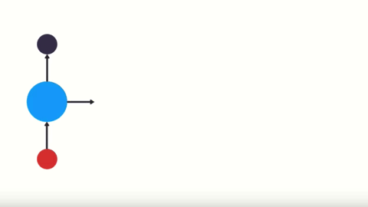
RNN
Recurrent Neural Networks

Slide 2
Introduction to RNN & Application
Image Captioning — It is used to caption an image by analyzing the activities present in it.
Time Series Prediction
Natural Language Processing — Text mining & Sentiment Analysis
Machine Translation — By taking input in one language, RNN can be used to translate it to different languages as output.

Slide 3
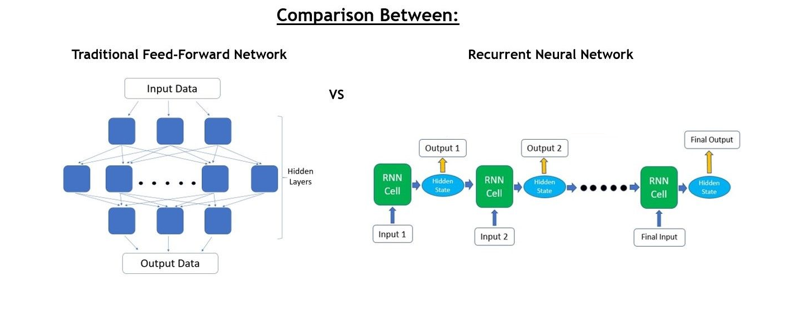

Feed-Forward Network
Notes:
Traditional feed-forward neural networks take in a fixed amount of input data all at the same time and produce a fixed amount of output each time. On the other hand, RNNs do not consume all the input data at once. Instead, they take them in one at a time and in a sequence. At each step, the RNN does a series of calculations before producing an output.
The output, known as the hidden state, is then combined with the next input in the sequence to produce another output. This process continues until the model is programmed to finish or the input sequence ends.
Issues in the feed forward neural network : –
Can’t handle sequential data.
Consider only current input.
Can’t memorize the previous input.
Feed-forward nets don’t remember historic input data at test time unlike recurrent networks.

Slide 4
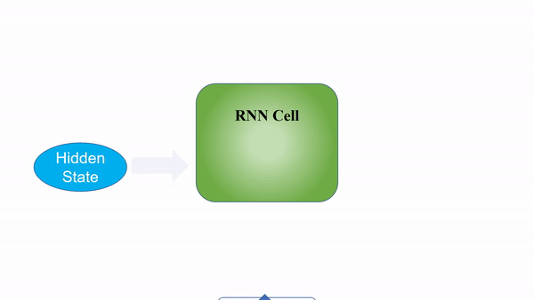
RNN Architecture
Notes:
Examle
“Ram lives in India. He speaks fluent ……”
What will make a good prediction is if you better know “He” is related to Ram and the country he lives in is India. Given this context, the suitable word according to me is “Hindi”. If you don’t know the first sentence (Ram lives in India), it would be difficult to predict the word “Hindi”,
As a simple example, consider that we want to predict the next number of the following sequence: 6 -> 7 -> 8 -> ?. We would like to have the next output to be 9 (x+1). However, if we provide this sequence: 2 -> 4 -> 8 -> ?, we would like to get 16 (2x). Although in both cases, the current last input was number 8, the prediction outcome should be different (when we take into account the contextual information of previous values and not only the last one).

Slide 5
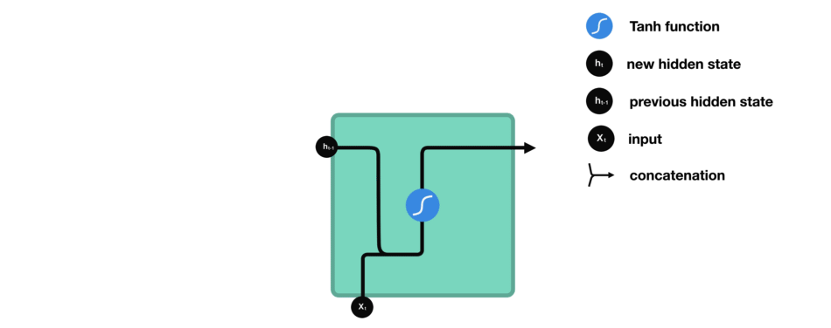

Slide 6
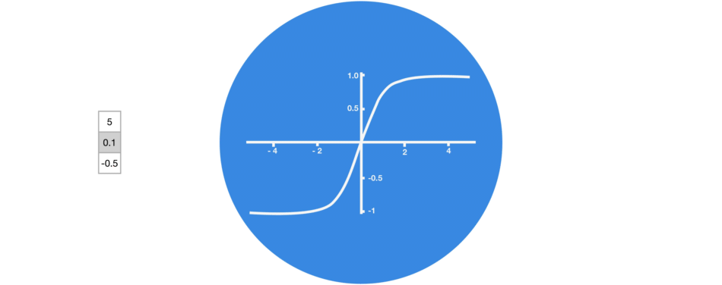
Tanh Activation

Slide 7
Types of RNN architectures
One to One : — It is also known as vanilla neural network. It is used for basic machine learning problems.
One to Many : — It has single input and many outputs. Application : used in image captioning like, what we saw in dog catching ball in the air previously.
Many to One : — It has many inputs and a single output. This is basically used in analyzing sentiments, where we give a sentence as an input and get sentiment regarding that as a output.
Many to Many : — It takes a sequence of inputs and generate a sequence of outputs. Application : Machine Translation

Slide 8


Slide 9

RNN Model
Notes:
X_{t} is input at time step t.
S_{t} is the hidden state at time step t. It’s the “memory” of the network. It is calculated based on the previous hidden state and the input at the current step.
O_{t} is the output at step t. For example, if we wanted to predict the next word in a sentence it would be a vector of probabilities across our vocabulary.
In short, the main feature of an RNN is its hidden state, which captures some information about a sequence and uses it accordingly whenever needed.

Slide 10
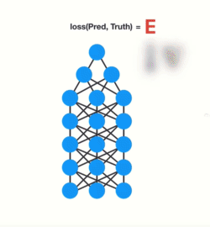
Vanish Gradient Problem

Slide 11
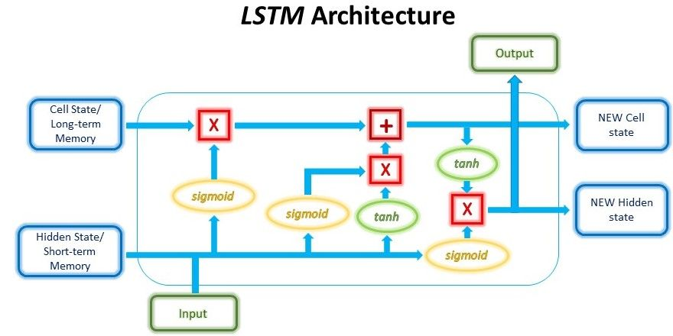
LSTM
Notes:
typical RNN is the problem of vanishing/exploding gradients. This problem arises when back-propagating through the RNN during training, especially for networks with deeper layers. The gradients have to go through continuous matrix multiplications during the back-propagation process due to the chain rule, causing the gradient to either shrink exponentially (vanish) or blow up exponentially (explode). Having a gradient that is too small prevents the weights from updating and learning, whereas extremely large gradients cause the model to be unstable.
Due to these issues, RNNs are unable to work with longer sequences and hold on to long-term dependencies, making them suffer from “short-term memory”.

Slide 12
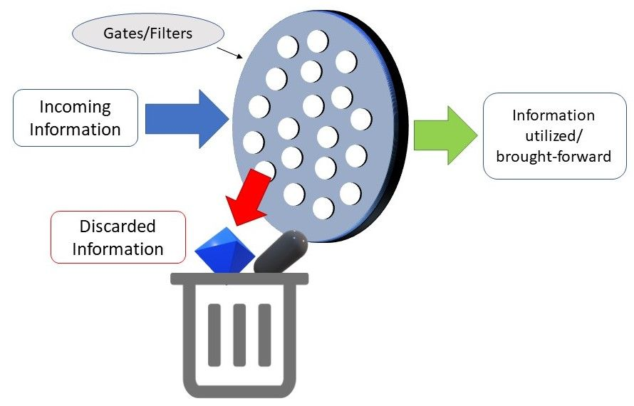

Slide 13
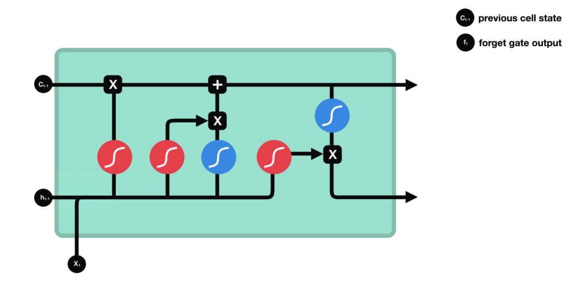
Forget get
This gate decides what information should be thrown away or kept. Information from the previous hidden state and information from the current input is passed through the sigmoid function.
Values come out between 0 and 1.
The closer to 0 means to forget, and the closer to 1 means to keep.

Slide 14
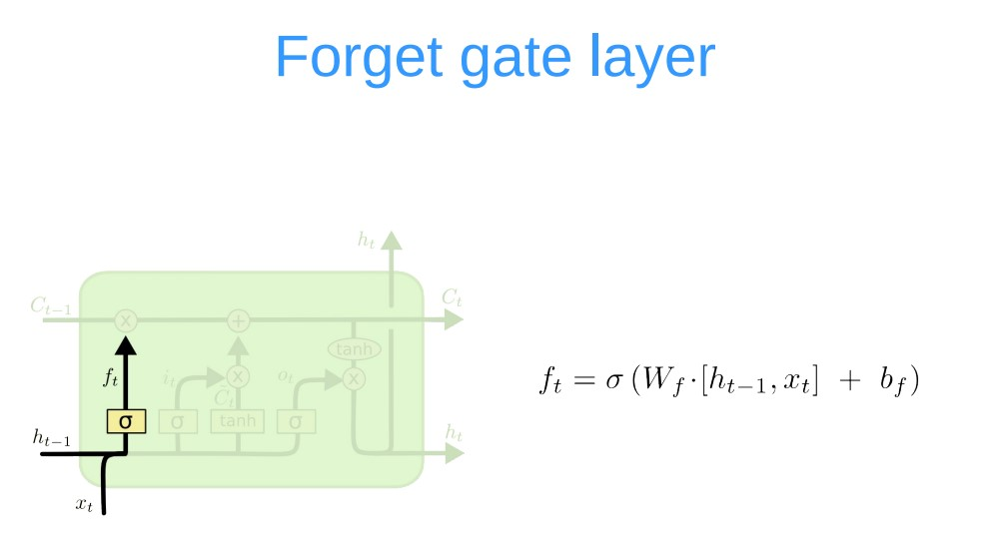

Slide 15
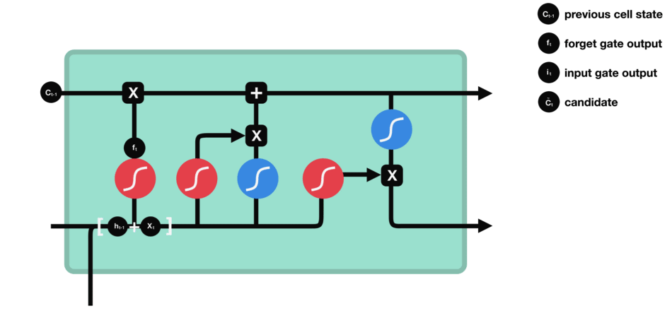
Input Get
To update the cell state, we have the input gate. First, we pass the previous hidden state and current input into a sigmoid function. That decides which values will be updated by transforming the values to be between 0 and 1. 0 means not important, and 1 means important.
You also pass the hidden state and current input into the tanh function to squish values between -1 and 1 to help regulate the network. Then you multiply the tanh output with the sigmoid output. The sigmoid output will decide which information is important to keep from the tanh output.

Slide 16
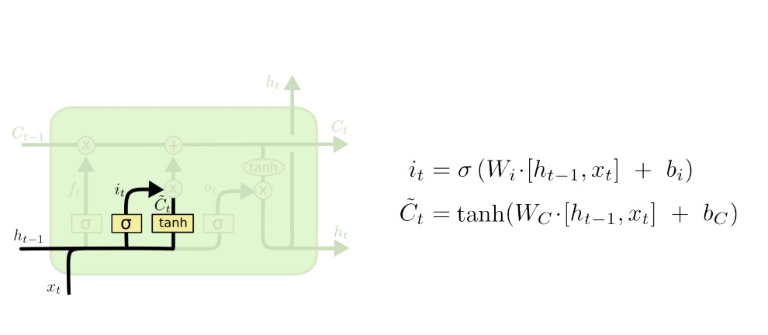

Slide 17
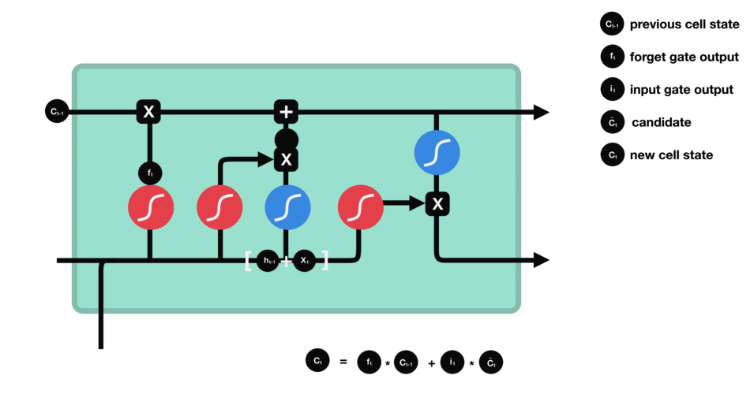
New Cell State
Now we should have enough information to calculate the cell state. First, the cell state gets pointwise multiplied by the forget vector. This has a possibility of dropping values in the cell state if it gets multiplied by values near 0. Then we take the output from the input gate and do a pointwise addition which updates the cell state to new values that the neural network finds relevant. That gives us our new cell state.

Slide 18
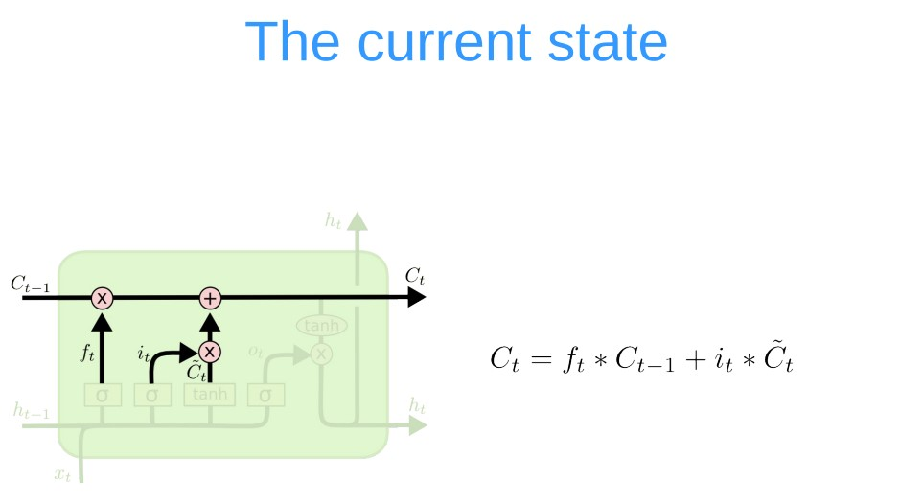

Slide 19

Output Get
The output gate decides what the next hidden state should be. Remember that the hidden state contains information on previous inputs. The hidden state is also used for predictions. First, we pass the previous hidden state and the current input into a sigmoid function. Then we pass the newly modified cell state to the tanh function.
We multiply the tanh output with the sigmoid output to decide what information the hidden state should carry.
The output is the hidden state. The new cell state and the new hidden is then carried over to the next time step.

Slide 20
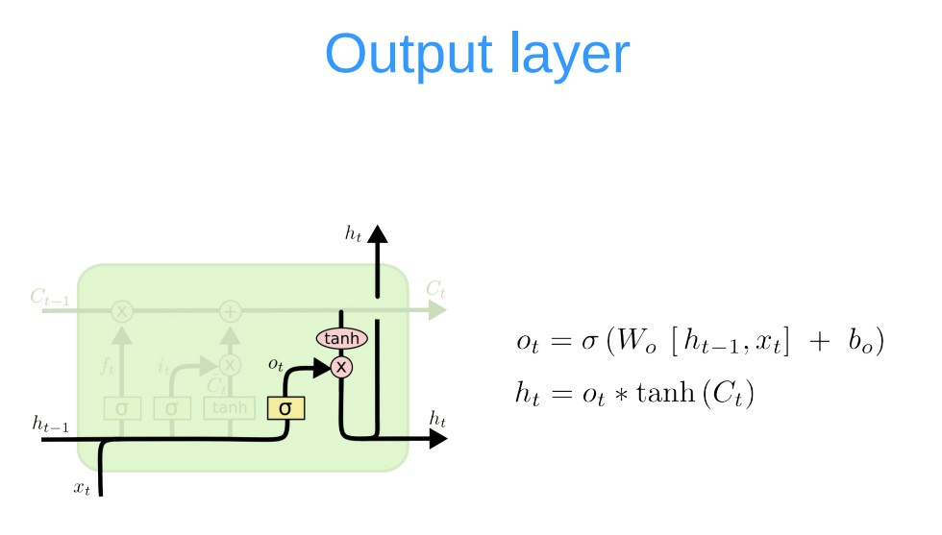

Slide 21
LSTM
The Forget gate decides what is relevant to keep from prior steps.
The input gate decides what information is relevant to add from the current step.
The output gate determines what the next hidden state should be.

